Slide 1
Project Presentation of CO-OP Project at Industry (Module-2) (22CS421)
On
Mood Detection and Environment Analyzation
Rupali Wadhwa
2210990748
Supervised By
Dr. Gurpreet Singh
Associate Professor
Department of Computer Science and Engineering,
Chitkara University, Punjab

Slide 2

Introduction
Human–computer interaction is evolving with intelligent systems that can understand human behavior.
AI-based mood detection helps in analyzing emotions and improving system responses.
It has applications in mental health, education, marketing, security, and personalized systems.
Traditional systems only respond to commands, but modern systems can understand non-verbal cues.
Deep learning enables detection of emotions, behavior patterns, and surroundings.
2

Slide 3

Problem Statement
Many existing emotion detection systems are limited because they focus only on identifying facial expressions without considering the surrounding environment. This lack of context makes it difficult to understand why a person is showing a particular emotion or how external factors influence it. As a result, these systems often struggle with real-time performance, handling multiple individuals, and tracking emotional patterns over time. Research also shows that factors like lighting, background, noise, and location can significantly affect accuracy when ignored. Therefore, there is a need for a more advanced system that combines emotion detection with environmental analysis to provide a deeper and more meaningful understanding of human behavior.
3

Slide 4

Objectives
Detects and classifies emotional states from live video streams using deep learning.
Identifies and analyzes the surroundings to provide environmental context.
Supports multi-person emotional recognition and visualization simultaneously.
Displays emotional states, scene information, timestamps, and person count in real time.
Generates emotion frequency graphs dynamically to track behavioral trends.
Demonstrates scalable architecture suitable for research, behavioral analytics, and real-world deployment.
4

Slide 5
Limitations
Environmental factors – Low lighting, extreme camera angles, or motion blur may reduce accuracy.
Model bias – Pre-trained models may not fully represent cultural or demographic diversity.
Emotion recognition – Limited to predefined classes; subtle or mixed emotional states may not be detected.
No long‑term storage or cloud analytics – Currently offline for privacy/simplicity, but architecture supports future integration.
Scene recognition – Visually similar environments may occasionally be misclassified.
5

Slide 6
Proposed System
The system overcomes limitations of traditional emotion detection methods by using pre-trained deep learning models instead of training datasets.
It works on live webcam input and performs real-time analysis of human emotions and surroundings.
Mood detection and environment recognition are carried out simultaneously for better understanding.
It provides real-time output including emotion, scene type, timestamp, and number of people detected.
The system performs context-aware analysis by combining emotional data with environmental conditions.
It supports detection of multiple individuals and summarizes group emotions effectively.
The design is modular, allowing future enhancements like cloud integration, mobile deployment, and audio-based analysis.
6

Slide 7
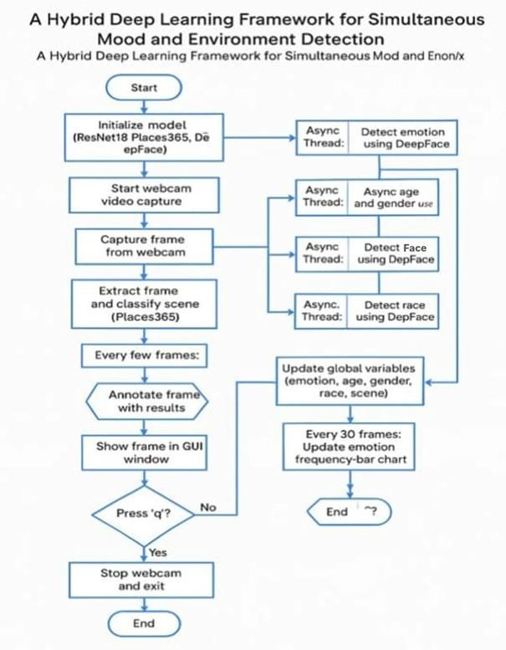
System Architecture
7

Slide 8
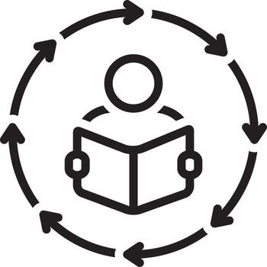
Methodology / Working
The system follows a structured step-by-step pipeline:
Capturing live video stream using the webcam.
Processing frames for emotion inference using pretrained models.
Running environment analysis at intervals for context recognition.
Detecting and counting individuals present in the frame.
Annotating the results directly onto the live feed.
Updating the real-time emotion distribution graph.
Displaying combined output through an interactive window.
8

Slide 9
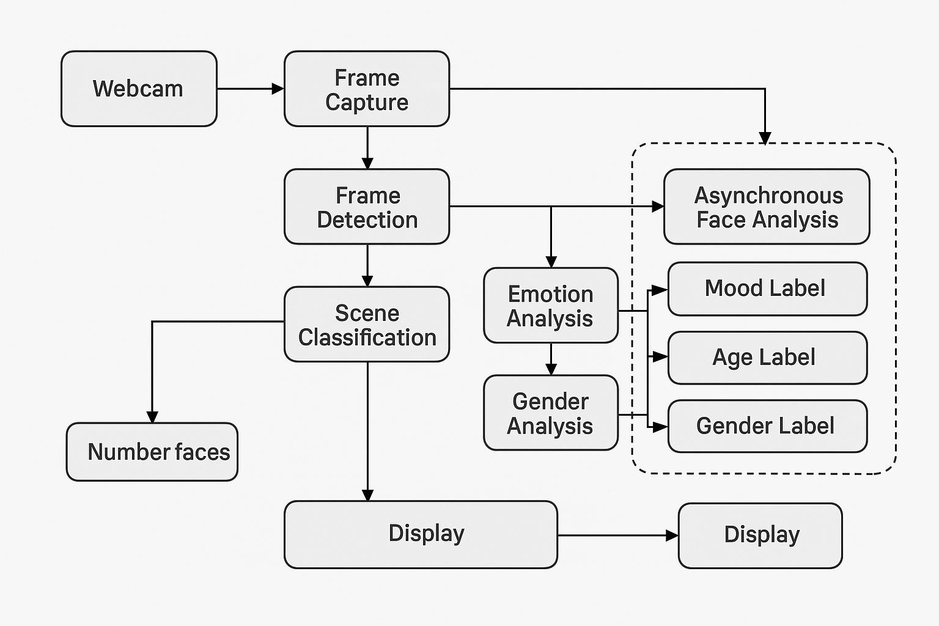
Methodology / Working
9

Slide 10

Tools & Technologies
Python – Used as the main programming language for developing the entire system.
OpenCV – Helps in capturing live video, detecting faces, and displaying results with proper visual output.
DeepFace – Used for detecting facial attributes such as emotion, age, gender, and race.
ResNet18 (Places365 Model) – A pre-trained model used to recognize and classify the surrounding environment.
MTCNN – Used for accurate face detection and identifying facial landmarks.
Deep Learning & CNNs – Core techniques used for processing and analyzing image data.
Computer Vision – Enables the system to understand and interpret visual input from the webcam.
Multithreading – Ensures smooth execution by running multiple tasks simultaneously without slowing down the system.
10

Slide 11
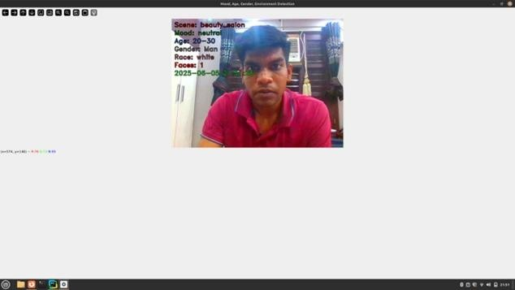
Results
A graphical representation of emotional trends was displayed alongside the live video feed to provide a visual summary of emotional patterns over time.
11

Slide 12

Future Scope
Emotion detection can be enhanced to identify complex and subtle emotions beyond basic categories.
Integration of voice-based sentiment analysis can improve overall accuracy of emotion recognition.
Cloud storage and processing can be added for long-term data tracking and remote access.
The system can be extended to mobile and IoT devices for wider real-world applications.
Advanced features like gesture, posture, and gaze detection can improve behavioral analysis.
Models can be improved using personalized learning and cross-cultural adaptation for better accuracy.
12

Slide 13

Conclusion
Live AI Interprets Emotion with Contextual Awareness
No Curated Datasets or Offline Processing
Pretrained Models + Real-Time Webcam Input
Accessible, Scalable, Deployable in Everyday Settings
Real-Time Emotion ID, Multi-Person Awareness, and Scene Classification
Live Output Overlays and Trend Graphs
Environment Recognition Enhances Emotional Interpretation
Intelligent, Responsive, Context-Driven Mood Recognition Platform
Ready for Education, Analytics, Security, Adaptive UIs, and Mental Health Support
13

Slide 14
Thank You
14

